Slide 1
CIS 7000-005 Neural Scene Representation & Neural Rendering Tutorial Lecture: NeRF Studio
Dec 9th

Slide 2
Overview
Nerfstudio + command lines (on Linux) = train a neural representation
1. Installation
2. How to train an Instant-NGP model on an existing dataset
3. How to train a Splatfacto model (a variant of original 3D Gaussian Splatting model provided by nerfstudio) on a custom dataset
4. A brief guide for further development
Notes:
In this tutorial lecture, we will show you how to use nerfstudio to train a neural representation purely with command lines on Linux, which includes
1. How to install nerfstudio and corresponding dependencies
2. How to train an Instant-NGP model on an existing dataset
3. How to train a Splatfacto model (a variant of original 3D Gaussian Splatting model provided by nerfstudio) on a custom dataset
4. A brief guide for further development

Slide 3
Overview
Nerfstudio + command lines (on Linux) = train a neural representation
1. Installation
2. How to train an Instant-NGP model on an existing dataset
3. How to train a Splatfacto model (a variant of original 3D Gaussian Splatting model provided by nerfstudio) on a custom dataset
4. A brief guide for further development
Notes:
(1) Check the nerfstudio document for more tutorials.
(2) You can find a colab demo here, which is an easier way to experience nerfstudio.
But our tutorial aims for a slightly more in-depth instruction
(3) We will release the slides after class. All the commands can be found in the notes

Slide 4
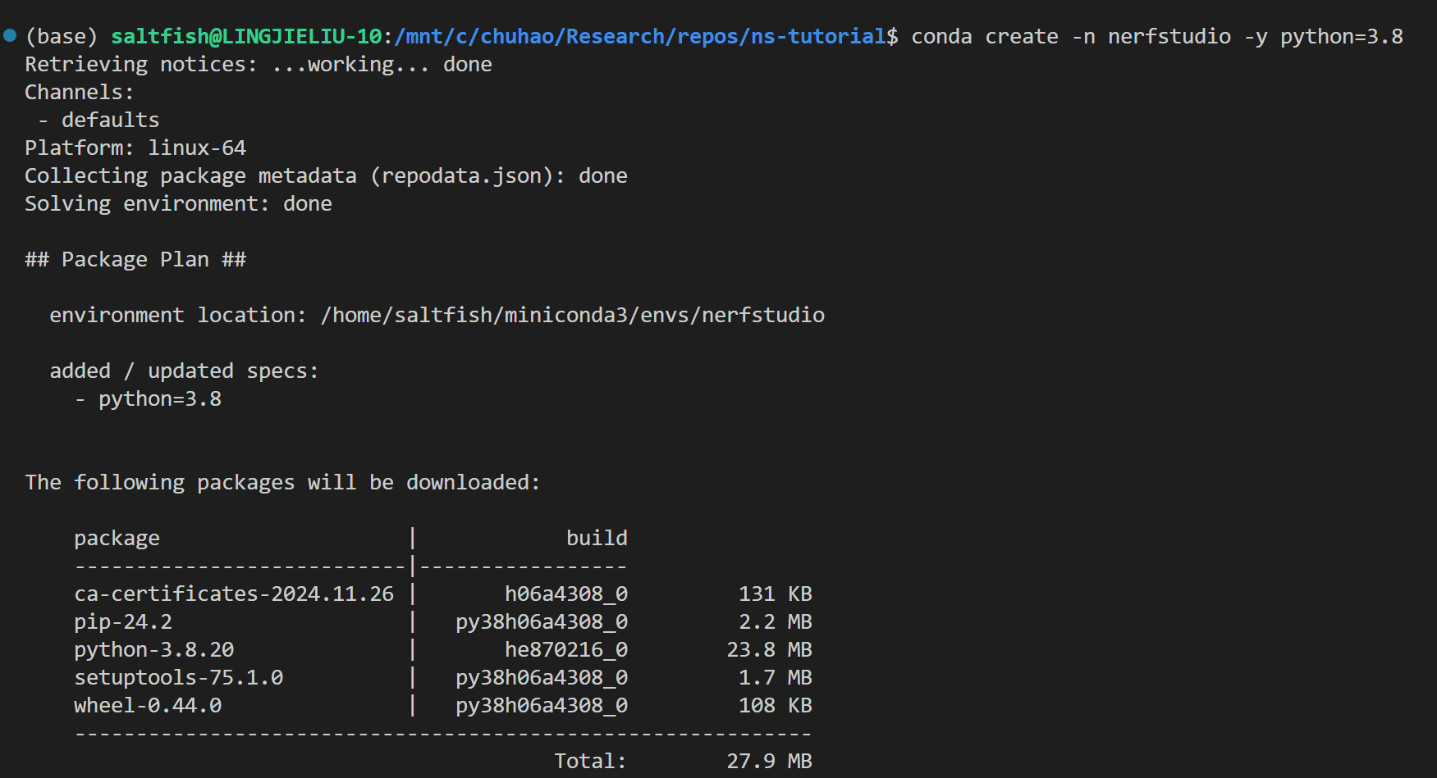
Installation
1. Create & Activate a conda environment
(Note: If you have never used conda before, it’s recommended to quickly install Miniconda with the command line)
Notes:
conda create -n nerfstudio -y python=3.8

Slide 5
Overview
Nerfstudio + command lines (on Linux) = train a neural representation
1. Installation
2. How to train an Instant-NGP model on an existing dataset
3. How to train a Splatfacto model (a variant of original 3D Gaussian Splatting model provided by nerfstudio) on a custom dataset
4. A brief guide for further development
Notes:
In this tutorial lecture, we will show you how to use nerfstudio to train a neural representation purely with command lines on Linux, which includes
1. How to install nerfstudio and corresponding dependencies
2. How to train an Instant-NGP model on an existing dataset
3. How to train a Splatfacto model (a variant of original 3D Gaussian Splatting model provided by nerfstudio) on a custom dataset
4. A brief guide for further development

Slide 6
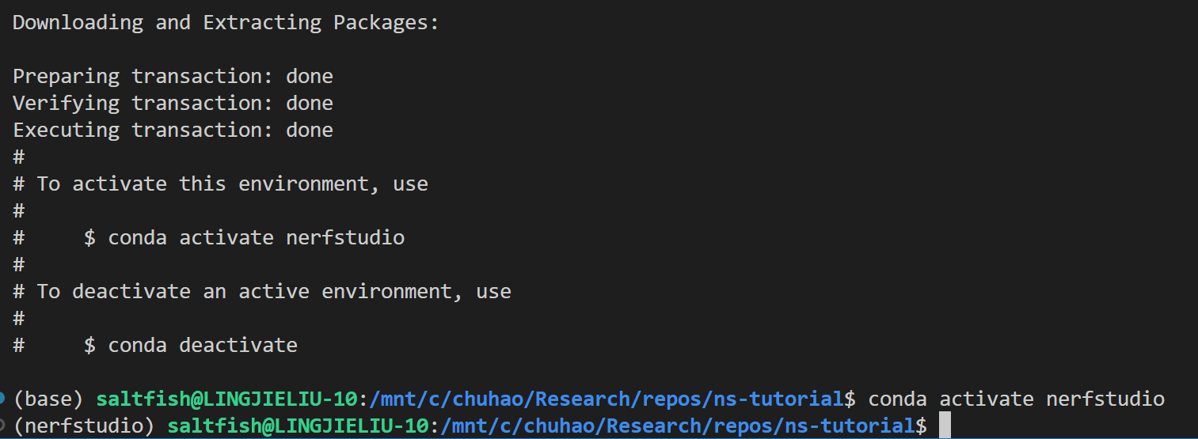
Installation
1. Create & Activate a conda environment
(Note: If you have never used conda before, it’s recommended to quickly install Miniconda with the command line)
Successful!
Notes:
conda activate nerfstudio

Slide 7
Installation
2. Install PyTorch
It’s not strict which version of PyTorch and the corresponding CUDA you should use, but installing tiny-cuda-nn in the next step requires a matching version of the CUDA Compiler installed in your computer and the CUDA used to compile PyTorch. So choose them carefully!
Check the valid combination of PyTorch and CUDA versions and related download commands here
(Note: Google or Ask ChatGPT when you run into an incompatibility/missing library issue)
Notes:
pip install torch==2.1.2 torchvision==0.16.2 torchaudio==2.1.2 --index-url https://download.pytorch.org/whl/cu121

Slide 8
Installation
3. Install tiny-cuda-nn and nerfstudio
Similar with installing PyTorch from pip
(Note: It might take a long time to compile & install tiny-cuda-nn. In addition, you might encounter a lot of issues in installing it. The best way to solve them is to check the similar issues at github)
Notes:
pip install ninja git+https://github.com/NVlabs/tiny-cuda-nn/#subdirectory=bindings/torch

Slide 9
Installation
3. Install tiny-cuda-nn and nerfstudio
Similar with installing PyTorch from pip
(Note: It might take a long time to compile & install tiny-cuda-nn. In addition, you might encounter a lot of issues in installing it. The best way to solve them is to check the similar issues at github)
Notes:
pip install nerfstudio

Slide 10
Overview
Nerfstudio + command lines (on Linux) = train a neural representation
1. Installation
2. How to train an Instant-NGP model on an existing dataset
3. How to train a Splatfacto model (a variant of original 3D Gaussian Splatting model provided by nerfstudio) on a custom dataset
4. A brief guide for further development
Notes:
In this tutorial lecture, we will show you how to use nerfstudio to train a neural representation purely with command lines on Linux, which includes
1. How to install nerfstudio and corresponding dependencies
2. How to train an Instant-NGP model on an existing dataset
3. How to train a Splatfacto model (a variant of original 3D Gaussian Splatting model provided by nerfstudio) on a custom dataset
4. A brief guide for further development

Slide 11
Train an InstantNGP model
Now you have installed everything you need. Let’s start training!
1. download an example data “poster”: with ns-download-data command
Notes:
ns-download-data nerfstudio --capture-name=poster

Slide 12
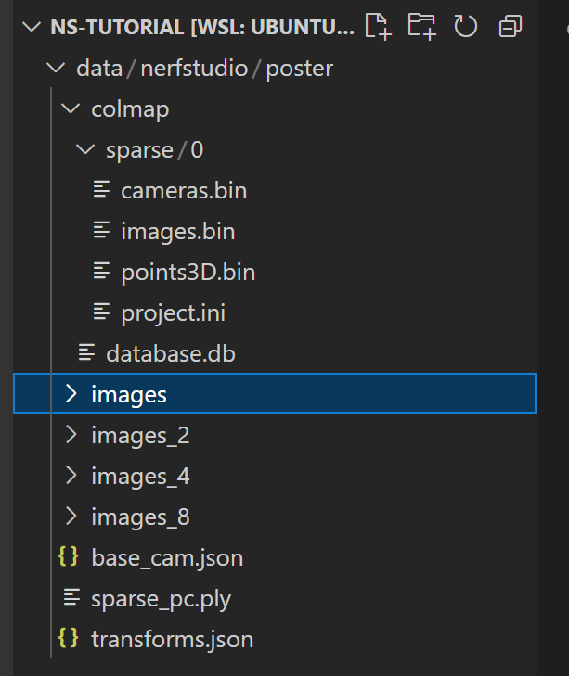
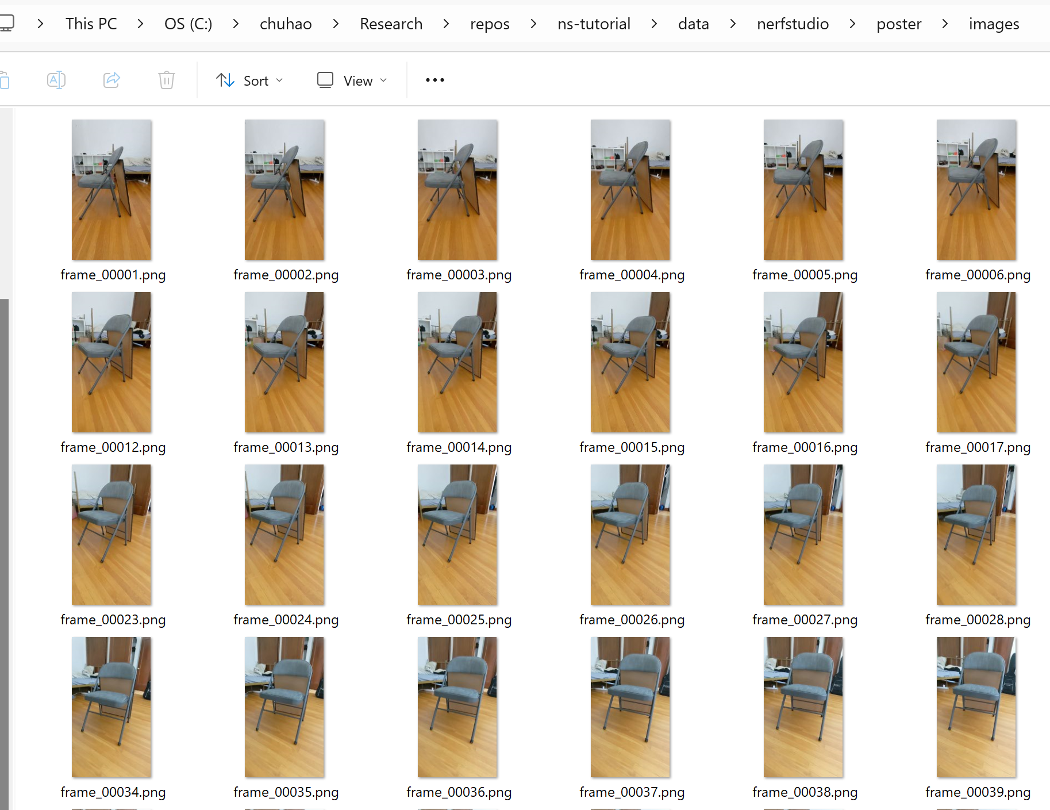
Train an InstantNGP model
Now you have installed everything you need. Let’s start training!
1. download an example data “poster”: with ns-download-data command
The downloaded dataset will be automatically converted into the correct format you need.
(Note: You are encouraged to delve into the data format, which benefits you in further development)

Slide 13
Train an InstantNGP model
2. Training(demo)
Notes:
ns-train instant-ngp --data data/nerfstudio/poster

Slide 14
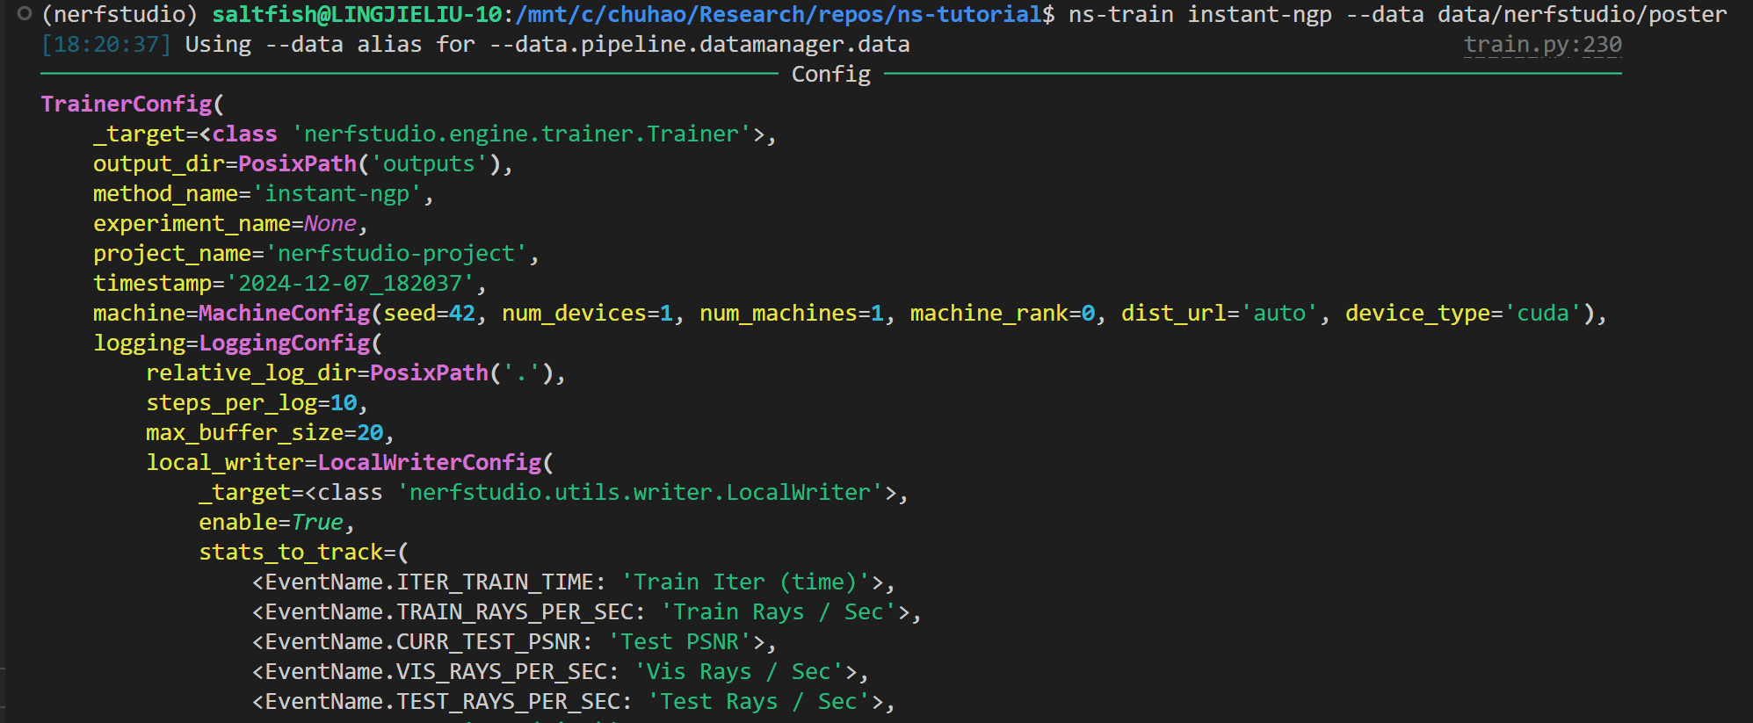
Train an InstantNGP model
2. Training(demo): you will see the config and the training progress
Notes:
ns-train instant-ngp --data data/nerfstudio/poster

Slide 15
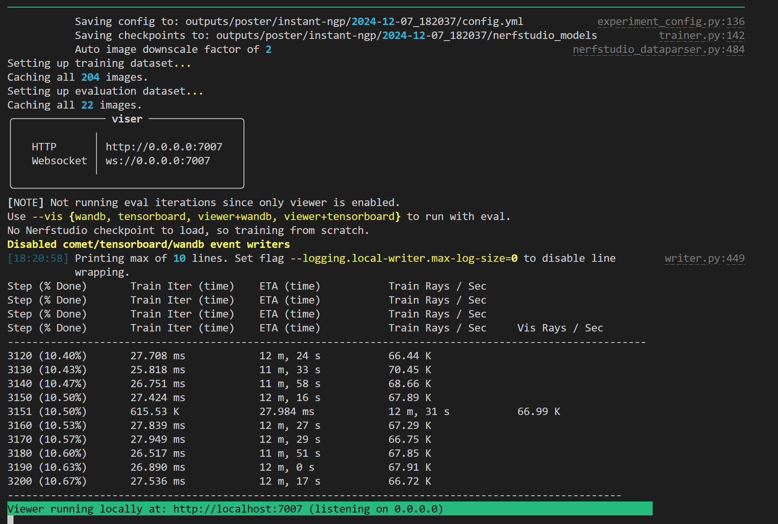
Train an InstantNGP model
2. Training: you will see the config and the training progress

Slide 16
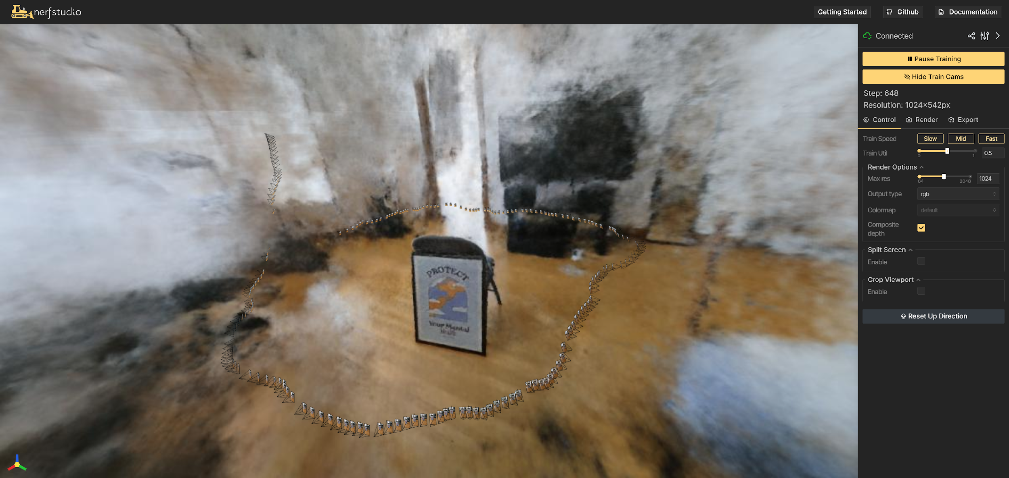
Train an InstantNGP model
Nerfstudio will start a web server for you to monitor the training progress conveniently

Slide 17
Train an InstantNGP model
We can find that Instant-NGP converges very fast!
It takes only ~2min to train 5k iterations (30k in total) on an Nvidia RTX 4090 GPU
~500 iterations
~1000 iterations
~2000 iterations
~5000 iterations

Slide 18
Overview
Nerfstudio + command lines (on Linux) = train a neural representation
1. Installation
2. How to train an Instant-NGP model on an existing dataset
3. How to train a Splatfacto model (a variant of original 3D Gaussian Splatting model provided by nerfstudio) on a custom dataset
4. A brief guide for further development
Notes:
In this tutorial lecture, we will show you how to use nerfstudio to train a neural representation purely with command lines on Linux, which includes
1. How to install nerfstudio and corresponding dependencies
2. How to train an Instant-NGP model on an existing dataset
3. How to train a Splatfacto model (a variant of original 3D Gaussian Splatting model provided by nerfstudio) on a custom dataset
4. A brief guide for further development

Slide 19
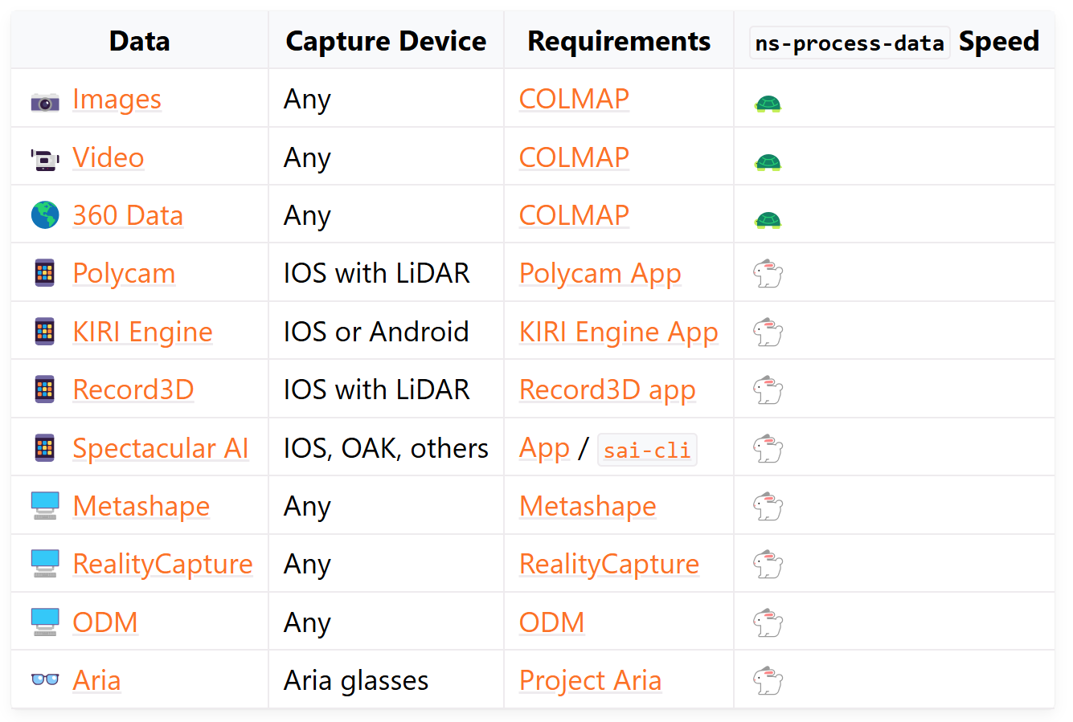
Train a Splatfacto model
Let’s switch to training an Splatfacto model with our own dataset.
1. Capture your data: format & devices supported by Nerfstudio ⬇️
Notes:
https://docs.nerf.studio/quickstart/custom_dataset.html

Slide 20
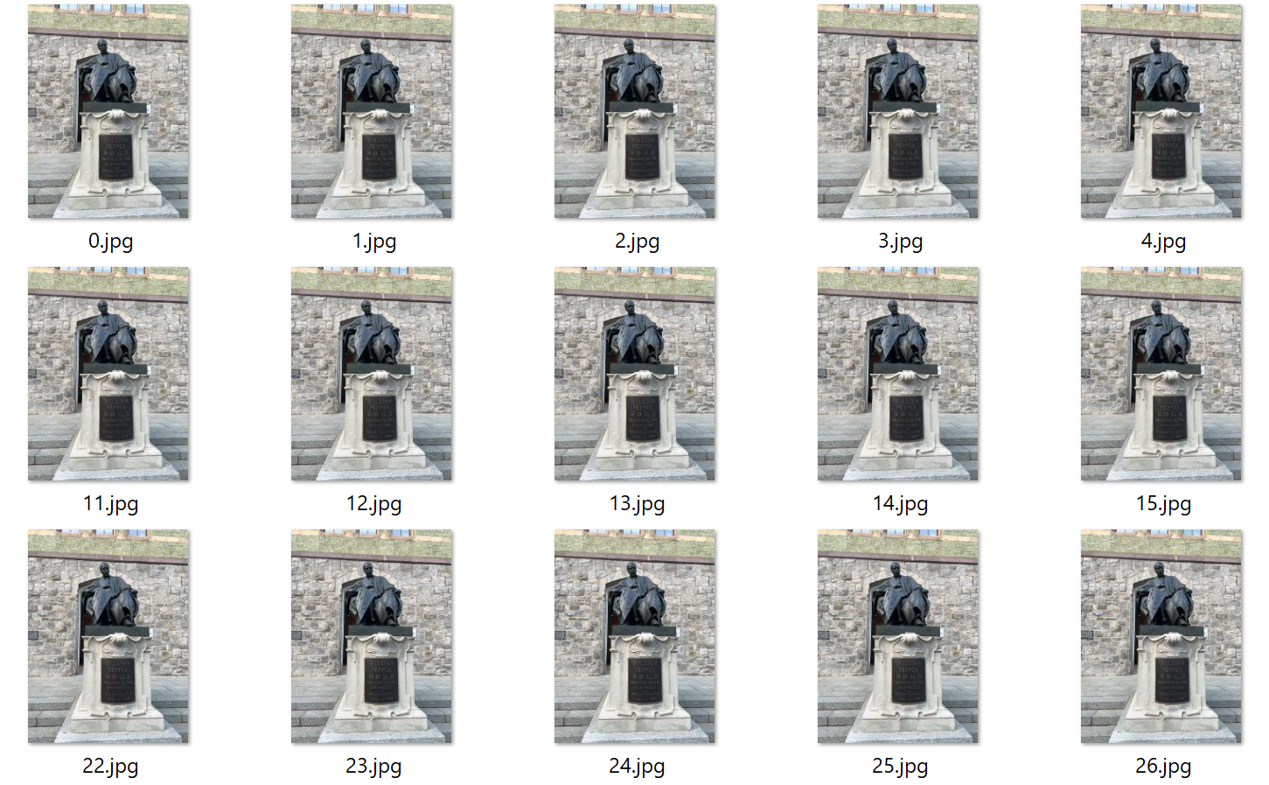
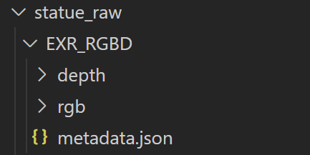
Train a Splatfacto model
Example:
device: IOS app Record3D.
format: raw RGBD data with camera poses
Notes:
https://docs.nerf.studio/quickstart/custom_dataset.html

Slide 21
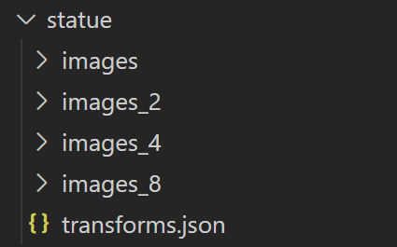
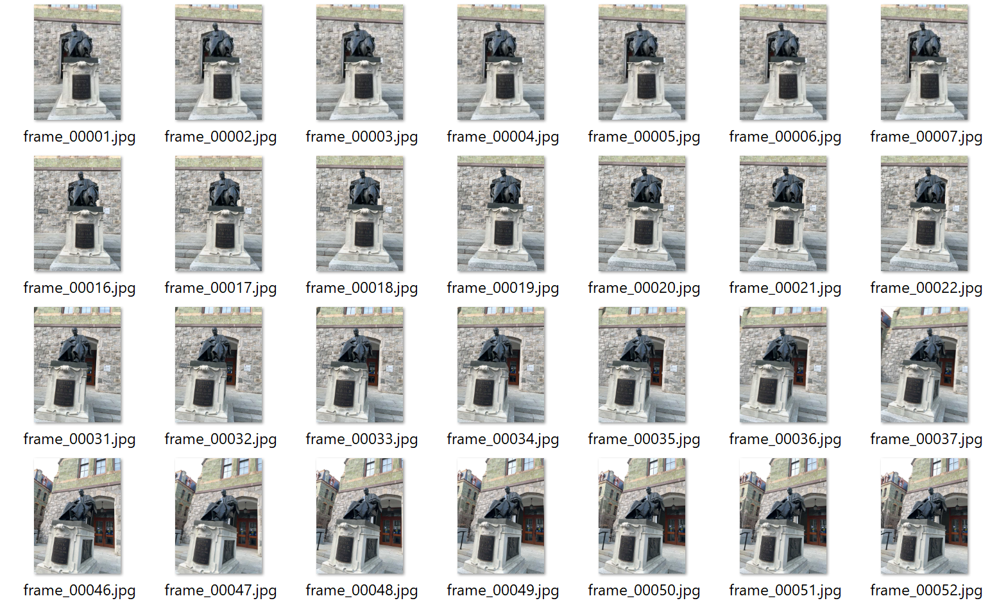
Train a Splatfacto model
2. Data processing: into standard format for nerfstudio
Notes:
ns-process-data record3d --data statue_raw/EXR_RGBD --output-dir statue

Slide 22
Train a Splatfacto model
Now let’s begin training!
3. pip install gsplat (for Splatfacto)
4. （Demo）training a Splatfacto model (similar to Instant-NGP)
Notes:
# We re-create the environment with Python3.10 here to install gsplat correctly
pip uninstall gsplat
pip install gsplat --index-url https://docs.gsplat.studio/whl/pt21cu121
ns-train splatfacto --data statue

Slide 23
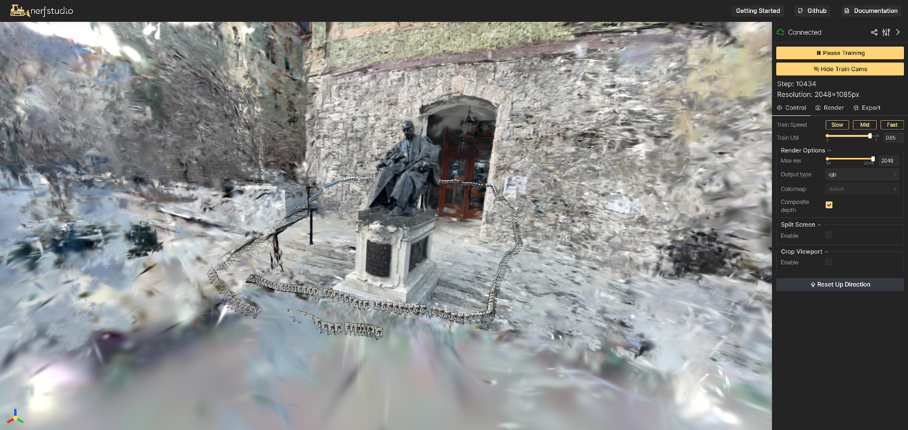
Train a Splatfacto model
Similarly, we can monitor the training process at a webserver

Slide 24
Overview
Nerfstudio + command lines (on Linux) = train a neural representation
1. Installation
2. How to train an Instant-NGP model on an existing dataset
3. How to train a Splatfacto model (a variant of original 3D Gaussian Splatting model provided by nerfstudio) on a custom dataset
4. A brief guide for further development
Notes:
In this tutorial lecture, we will show you how to use nerfstudio to train a neural representation purely with command lines on Linux, which includes
1. How to install nerfstudio and corresponding dependencies
2. How to train an Instant-NGP model on an existing dataset
3. How to train a Splatfacto model (a variant of original 3D Gaussian Splatting model provided by nerfstudio) on a custom dataset
4. A brief guide for further development

Slide 25
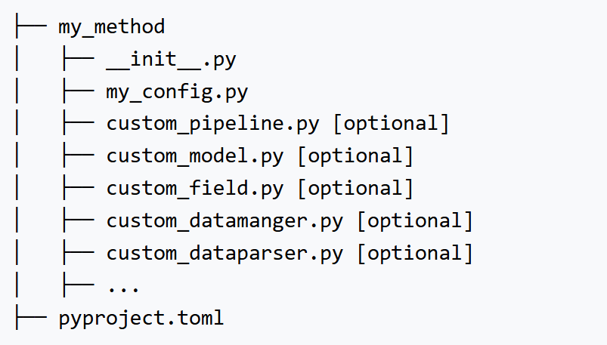
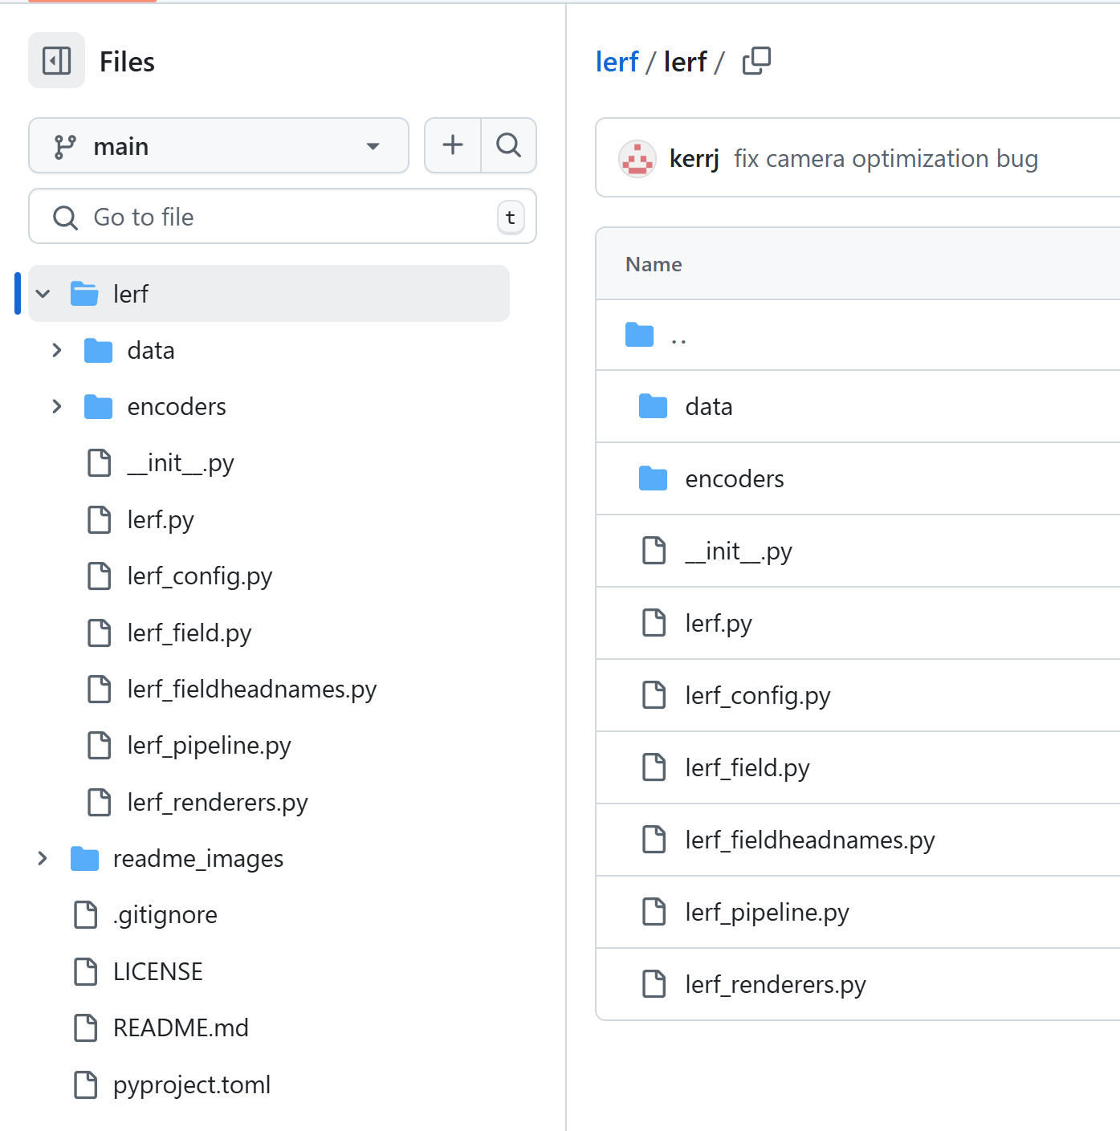
Further Development
Using Extensions:
Nerfstudio provides template for developing novel methods. A famous example is LERF¹ , which has its lightweight implementation depend on nerfstudio.
Template file structure for custom methods
LERF’s file structure
¹LERF: Language Embedded Radiance Fields (ICCV 2023 Oral)
Notes:
https://docs.nerf.studio/developer_guides/new_methods.html

Slide 26
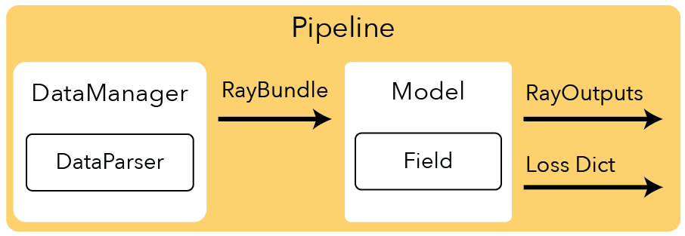
Further Development
Reading the Source Code:
In addition to playing nerfstudio only with its simple APIs, you are also encouraged to read the source code of nerfstudio to get into the detailed implementation of pipeline, dataloader, algorithm, etc.
This would benefit you in doing research in this field, whether or not you decide to design and implement your own methods based on nerfstudio.
Pipeline of nerfstudio
Notes:
https://github.com/nerfstudio-project/nerfstudio/

Slide 27
Tutorial Lecture: NeRF Studio
Thanks!

